Slide 1
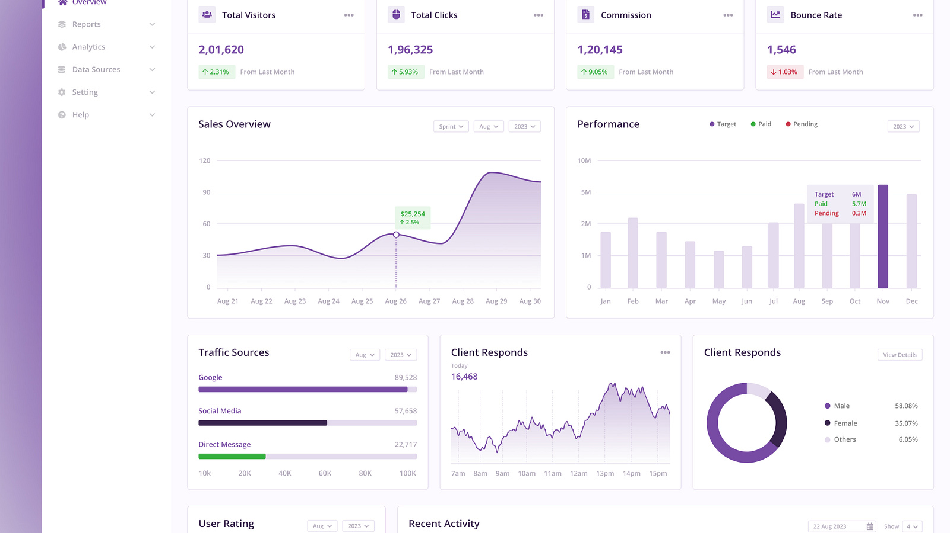
RETAIL MANAGEMENT PRESENTATION
Customer Behavior Analysis:
Driving Growth Through Data-Driven Insights
Strategic Analysis of Shopping Patterns, Customer Segments & Revenue Optimization
April 2026
Prepared for: NIKHIL KUMAR

Slide 2
Executive Summary
Key metrics and strategic findings from customer behavior analysis
TOTAL BASE
AVERAGE
RATING
3,900+
$59.76
3.75/5
Total Customers Analyzed
Average Purchase Amount
Average Review Rating
Key Findings
73% Non-Subscribers
Clothing Dominates
Massive conversion opportunity—nearly 3 out of 4 customers haven't subscribed
$100K+ revenue with ~1,800 orders—core category driving business
Young Adults Lead
100% Discount Rate
Generate highest revenue and sales volume—primary target segment
Universal discount application—opportunity for targeted optimization

Slide 3
Business Problem & Objectives
Defining the strategic challenge and our analytical approach
The Challenge
Our Objectives
Analyze purchasing patterns across demographics
Understand how age, gender, and location influence buying behavior
Identify drivers of customer loyalty and repeat purchases
Discover what makes customers return and increase lifetime value
"How can the company leverage consumer shopping data to identify trends, improve customer engagement, and optimize marketing and product strategies?"
Optimize marketing strategies by segment
Tailor campaigns to specific customer groups for maximum ROI
Improve product category performance
Identify high-potential categories and optimize inventory allocation
Increase subscription conversion rates
Convert the 73% non-subscribers into recurring revenue streams
Data-driven decision making is essential for competitive advantage

Slide 4
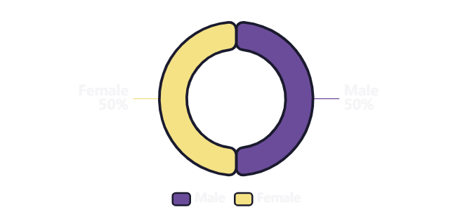
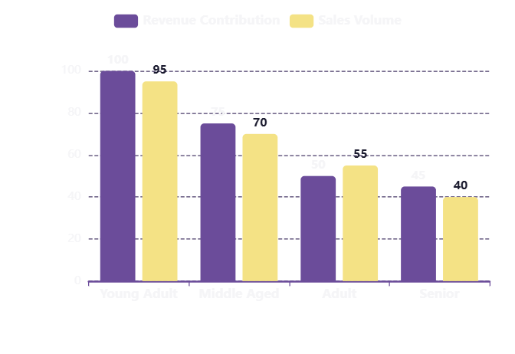
Customer Demographics Overview
Understanding who our customers are and how they perform
Gender Distribution
Age Group Performance
Balanced Dataset: Equal representation of Male and Female customers enables reliable cross-gender insights and unbiased strategic decisions.
Strategic Insight: Target Young Adults
Young Adults are the primary revenue drivers with the highest sales volume (~1.8M orders). Marketing campaigns and product development should prioritize this segment for maximum impact. Middle Aged customers show strong secondary performance, while Adult and Senior segments provide consistent, steady contribution.

Slide 5
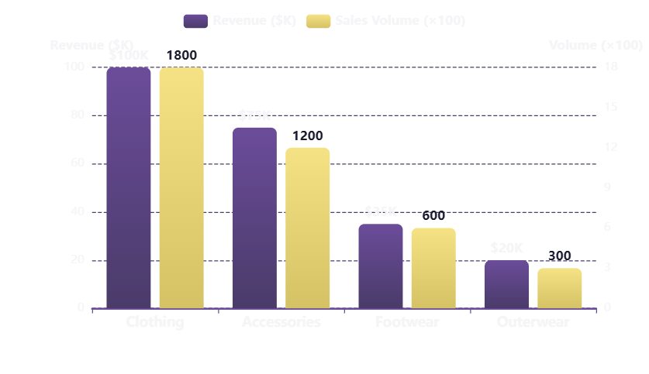
Revenue & Sales by Category
Category performance analysis revealing opportunities for optimization
Revenue vs Sales Volume
Category Performance Table
Category | Revenue | Volume | AOV
Clothing | $100K+ | ~1,800 | ~$55
Accessories | ~$75K | ~1,200 | ~$62
Footwear | ~$35K | ~600 | ~$58
Outerwear | ~$20K | ~300 | ~$67
Key Insights
•
Clothing is volume leader but lower AOV
•
Outerwear has highest AOV but lowest volume
•
Accessories show strong balance
Growth Opportunity: Outerwear Category
Outerwear commands the highest AOV ($67) but has the lowest sales volume (~300 orders). This represents a significant opportunity—increasing Outerwear marketing and visibility could drive substantial revenue growth with minimal volume increase needed.

Slide 6
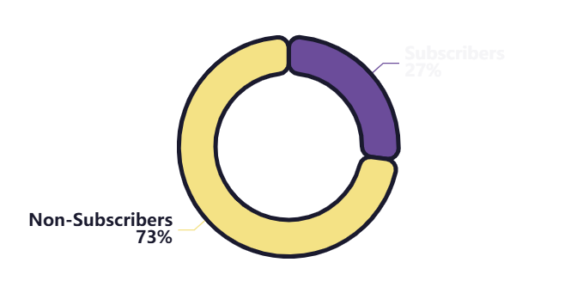
Customer Segmentation Analysis
Understanding subscription status and loyalty segments for targeted strategies
Subscription Status Breakdown
Customer Loyalty Segments
New Customers
ONBOARDING
1st Purchase
Focus on welcome campaigns, first-purchase incentives, and education about subscription benefits
Returning Customers
RETENTION
2-10 Purchases
Implement retention programs, personalized recommendations, and subscription conversion offers
27%
73%
Loyal Customers
VIP TREATMENT
Subscribers
Non-Subscribers
10+ Purchases
~1,053 customers
~2,847 customers
Provide exclusive benefits, early access, referral incentives, and advocacy programs
Critical Finding: Massive Conversion Opportunity
73% non-subscriber rate represents a massive untapped opportunity. Converting just 10% of non-subscribers (285 customers) to subscription could generate significant recurring revenue. Current subscribers show strong engagement—replicating this success with the larger non-subscriber base is the highest-impact strategic priority.

Slide 7
Purchase Behavior & Preferences
Understanding how customers shop, pay, and receive their orders
Shipping Preferences
Payment Methods
Purchase Frequency
Store Pickup
POPULAR
Credit Card
Weekly
MOST COMMON
Express Shipping
POPULAR
Primary payment method—dominant usage
2-Day Shipping
POPULAR
PayPal
Bi-Weekly
COMMON
Strong preference—trusted digital wallet
Free Shipping
STRONG
Debit Card
Monthly
COMMON
Standard Shipping
LAGGING
Widely used—direct bank access
Venmo
Cash
Every 3 Months
Annually
Opportunity: Upgrade Standard shipping or incentivize faster options
Emerging
Growing
Seasonal buyers
Holiday shoppers
Key Behavioral Insight:
Customers prefer fast, flexible shipping (Express, 2-Day, Store Pickup), trusted payment methods (Credit Card, PayPal), and frequent purchasing (Weekly/Bi-Weekly). Tailor experiences to these preferences for higher satisfaction and conversion.

Slide 8
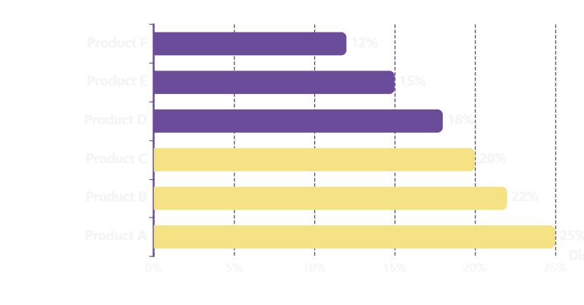
Discount & Promotion Impact
Analyzing discount effectiveness and optimization opportunities
Discount Analysis Metrics
Top Products by Discount Rate
Discount Application Rate
100%
All analyzed transactions include discounts
Promo Code Correlation
100%
Perfect alignment with discount usage
High-Value Discount Users
$59.76+
Still spend above average with discounts
Current Strategy: Universal Discounting
Recommendation: Targeted Discounting
The 100% discount application rate indicates a blanket discount approach. While this drives volume, it may be eroding margins on products that would sell without discounts.
Shift from universal to segment-based discounting: Offer higher discounts to new customers and non-subscribers, while reducing discounts for loyal, high-AOV customers.

Slide 9
Strategic Recommendations
Priority actions to drive 20%+ revenue growth
1
IMMEDIATE PRIORITY
2
SHORT-TERM
Launch Subscriber Conversion Campaign
Increase Outerwear Marketing
Target the 73% non-subscribers (2,847 customers) with personalized subscription offers at checkout, email campaigns, and exclusive benefits.
Outerwear has the highest AOV ($67) but lowest volume (~300 orders). Increase visibility through targeted ads, seasonal campaigns, and bundling.
Expected Impact:
Expected Impact:
+20-30%
+15%
Recurring Revenue Increase
Category Revenue Growth
Checkout Integration
Email Campaigns
Exclusive Benefits
Targeted Ads
Seasonal Campaigns
Product Bundling
3
MEDIUM-TERM
4
ONGOING
Implement Tiered Loyalty Program
Optimize Shipping Options
Create structured program for New, Returning, and Loyal customers with escalating benefits to drive retention and increase lifetime value.
Align shipping options with customer preferences. Promote Express and 2-Day shipping while improving Standard shipping value proposition.
Expected Impact:
Expected Impact:
Improved
Higher
Customer Retention Rate
Customer Satisfaction
Points System
Tiered Benefits
VIP Access
Free Shipping Thresholds
Express Incentives
Data-Driven Tactics:
Target Young Adults with personalized Clothing campaigns • Promote subscription benefits at checkout for non-subscribers • A/B test shipping incentives vs. product discounts

Slide 10

Conclusion & Next Steps
Transforming insights into action
Executive Summary
"Data reveals clear opportunities: convert non-subscribers, optimize high-AOV categories, and personalize by demographic segments. The foundation for 20%+ revenue growth exists in current customer behavior patterns."
Immediate Next Steps
1
Week 1
2
Week 2
3
Week 3
4
Month 2
Present Findings
Design Campaign
Implement Dashboard
Launch Pilots
Share analysis with marketing & product teams
Create subscriber conversion campaign
Set up KPI monitoring system
Deploy top 2 recommendations
3,900+
20%+
73%
Customers Analyzed
Revenue Growth Potential
Conversion Opportunity
Questions & Discussion

